Slide 1
Scenario
You are a cybersecurity analyst working at a company that specializes in providing IT services for clients. Several customers of clients reported that they were not able to access the client company website www.yummyrecipesforme.com, and saw the error “destination port unreachable” after waiting for the page to load.
You are tasked with analyzing the situation and determining which network protocol was affected during this incident.
To start, you attempt to visit the website and you also receive the error “destination port unreachable.”
To troubleshoot the issue, you load your network analyzer tool, tcpdump, and attempt to load the webpage again. To load the webpage, your browser sends a query to a DNS server via the UDP protocol to retrieve the IP address for the website's domain name; this is part of the DNS protocol. Your browser then uses this IP address as the destination IP for sending an HTTPS request to the web server to display the webpage The analyzer shows that when you send UDP packets to the DNS server, you receive ICMP packets containing the error message: “udp port 53 unreachable.”

Slide 2
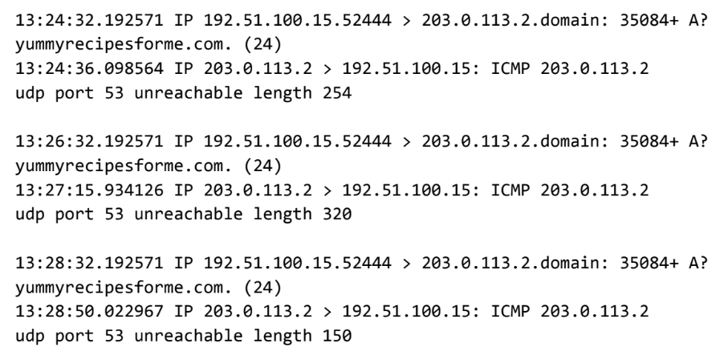
In the tcpdump log, you find the following information:
The first two lines of the log file show the initial outgoing request from your computer to the DNS server requesting the IP address of yummyrecipesforme.com. This request is sent in a UDP packet.
The third and fourth lines of the log show the response to your UDP packet. In this case, the ICMP 203.0.113.2 line is the start of the error message indicating that the UDP packet was undeliverable to port 53 of the DNS server.
In front of each request and response, you find timestamps that indicate when the incident happened. In the log, this is the first sequence of numbers displayed: 13:24:32.192571. This means the time is 1:24 p.m., 32.192571 seconds.
After the timestamps, you will find the source and destination IP addresses. In the first line, where the UDP packet travels from your browser to the DNS server, this information is displayed as: 192.51.100.15 > 203.0.113.2.domain. The IP address to the left of the greater than (>) symbol is the source address, which in this example is your computer’s IP address. The IP address to the right of the greater than (>) symbol is the destination IP address. In this case, it is the IP address for the DNS server: 203.0.113.2.domain. For the ICMP error response, the source address is 203.0.113.2 and the destination is your computers IP address 192.51.100.15.
After the source and destination IP addresses, there can be a number of additional details like the protocol, port number of the source, and flags. In the first line of the error log, the query identification number appears as: 35084. The plus sign after the query identification number indicates there are flags associated with the UDP message. The "A?" indicates a flag associated with the DNS request for an A record, where an A record maps a domain name to an IP address. The third line displays the protocol of the response message to the browser: "ICMP," which is followed by an ICMP error message.
The error message, "udp port 53 unreachable" is mentioned in the last line. Port 53 is a port for DNS service. The word "unreachable" in the message indicates the UDP message requesting an IP address for the domain "www.yummyrecipesforme.com" did not go through to the DNS server because no service was listening on the receiving DNS port.
The remaining lines in the log indicate that ICMP packets were sent two more times, but the same delivery error was received both times.

Slide 3
Now that you have captured data packets using a network analyzer tool, it is your job to identify which network protocol and service were impacted by this incident.
Then, you will need to write a follow-up report.
Provide a summary of the problem found in the tcpdump log
After analyzing the data presented to you from the tcpdump log, identify trends in the data. Assess which protocol is producing the error message from the DNS server for the yummyrecipesforme.com website. Recall that one of the ports that is displayed repeatedly is port 53, commonly used for DNS. In your analysis:
Include a brief summary of the tcpdump log analysis and identify which protocols were used for the network traffic.
Provide a few details about what was indicated in the log.
Interpret the issues found in the log.
Record your responses in part one of the cybersecurity incident report.
Explain your analysis of the data and provide one solution to implement
Now that you’ve inspected the traffic log and identified trends in the traffic, describe why the error messages appeared on the log. Use your answer in the previous step and the scenario to identify the reason behind the ICMP error messages. The error messages indicate that there is an issue with a specific port. What do the different protocols involved in the log reveal about the incident? In your response:
State when the problem was first reported.
Provide the scenario, events, and symptoms identified when the event was first reported.
Explain the current status of the issue.
Describe the information discovered while investigating the issue up to this point.
List the next steps in troubleshooting and resolving the issue.
Provide the suspected root cause of the problem.
Record your responses in part two of the cybersecurity incident report.

Slide 4
Example of a Cybersecurity Incident Report
Part 1: Provide a summary of the problem found in the DNS and ICMP traffic log
The network protocol analyzer logs indicate that port 443 is unreachable when attempting to access the secure employee background check website. Port 443 is normally used for HTTPS traffic. This may indicate a problem with the web server or the firewall configuration. It is possible that this is an indication of a malicious attack on the web server.
Part 2: Explain your analysis of the data and provide at least one cause of the incident
The incident occurred earlier this morning when the human resources (HR) team reported that they could not reach the background check web portal. The network security team responded and began running tests with the network protocol analyzer tool tcpdump. The resulting logs revealed that port 443, which is used for HTTPS traffic, is not reachable. We are continuing to investigate the root cause of the issue to determine how we can restore access to the secure web portal. Our next steps include checking the firewall configuration to see if port 443 is blocked and contacting the system administrator for the web server to have them check the system for signs of an attack. The HR team believes it is possible that a certain new hire may want to keep them from performing the background check. The network security team suspects this person might have launched an attack to crash the background check website.

Slide 5
Cybersecurity Incident Report: Network Traffic Analysis
Part 1: Provide a summary of the problem found in the DNS and ICMP traffic log.
The UDP protocol reveals that: the request for an IP address for the domain "www.yummyrecipesforme.com" did not go through to the DNS server because no service was listening on the receiving DNS port. This is based on the results of the network analysis, which show that the ICMP echo reply returned the error message: "udp port 53 unreachable" The port noted in the error message is used for: DNS service The most likely issue is: the DNS server may be offline, or there may be too much traffic which the DNS server cannot handle. It is possible that this is an indication of a malicious attack on the web server.
Part 2: Explain your analysis of the data and provide at least one cause of the incident.
Time incident occurred: It was alerted by our client – when troubleshooting, the time was 1:24pm 32 secs. Explain how the IT team became aware of the incident: Several customers of the client reported that they were not able to access the client company website. Explain the actions taken by the IT department to investigate the incident: The IT department cybersecurity analyst was tasked with analyzing the situation and determining which network protocol was affected during this incident. First we verify the issue that’s being faced, and then proceeded to troubleshoot the issue by utilizing a packet sniffer tool tcpdump and re-load the page. The tcpdump tool return a ICMP packet containing the error message: “udp port 53 unreachable.” Note key findings of the IT department's investigation (i.e., details related to the port affected, DNS server, etc.): port 53 which is the port for DNS service is unreachable. the request for an IP address for the domain "www.yummyrecipesforme.com" did not go through. Note a likely cause of the incident: If the DNS server is fine, the team should check the firewall settings to see if someone changed the configuration to block network traffic on port 53. Firewalls offer the ability to block network traffic on specific ports. Port blocking can be used to stop or prevent an attack.

Slide 6
Cybersecurity Incident Report: Network Traffic Analysis
Part 1: Provide a summary of the problem found in the DNS and ICMP traffic log.
As part of the DNS protocol, the UDP protocol was used to contact the DNS server to retrieve the IP address for the domain name of yummyrecipesforme.com. The ICMP protocol was used to respond with an error message, indicating issues contacting the DNS server. The UDP message going from our browser to the DNS server is shown in the first two lines of every log event. The ICMP error response from the DNS server to our browser is displayed in the third and fourth lines of every log event with the error message, “udp port 53 unreachable.” Since port 53 is associated with DNS protocol traffic, we know this is an issue with the DNS server. Issues with performing the DNS protocol are further evident because the plus sign after the query identification number 35084 indicates flags with the UDP message and the “A?” symbol indicates flags with performing DNS protocol operations. Due to the ICMP error response message about port 53, it is highly likely that the DNS server is not responding. This assumption is further supported by the flags associated with the outgoing UDP message and domain name retrieval.
Part 2: Explain your analysis of the data and provide at least one cause of the incident.
The incident occurred today at 1:24 p.m. Customers notified the organization that they received the message “destination port unreachable” when they attempted to visit the website yummyrecipesforme.com. We are currently investigating the issue so customers can access the website again. In our investigation into the issue, we conducted packet sniffing tests using tcpdump. In the resulting log file, we found that DNS port 53 was unreachable. The next step is to identify whether the DNS server is down or traffic to port 53 is blocked by the firewall. DNS server might be down due to a successful Denial of Service attack or a misconfiguration.

